Slide 1
Business Models Post Corona
The case of Aarhus and Copenhagen, Denmark

Slide 2
The hotel sector in Denmark
Investigate how the pandemic has impacted the hospitality sector in selected northern countries, Denmark, Iceland, and Latvia
The case of Denmark:
Milestone 1: I have conducted 6 in depth qualitative interviews with senior managers from MICE hotels in the city of Aarhus (May 2022)
Milestone 2: I have conducted desk research in the case of the hospitality sector of Copenhagen (September - November 2022)
Outcome: 2 articles that we now use in our teaching in the AP-degree

Slide 3
Findings – The hotel sector in Aarhus
Economic considerations
Employees
Sustainability
Other changes as consequence of the pandemic

Slide 4
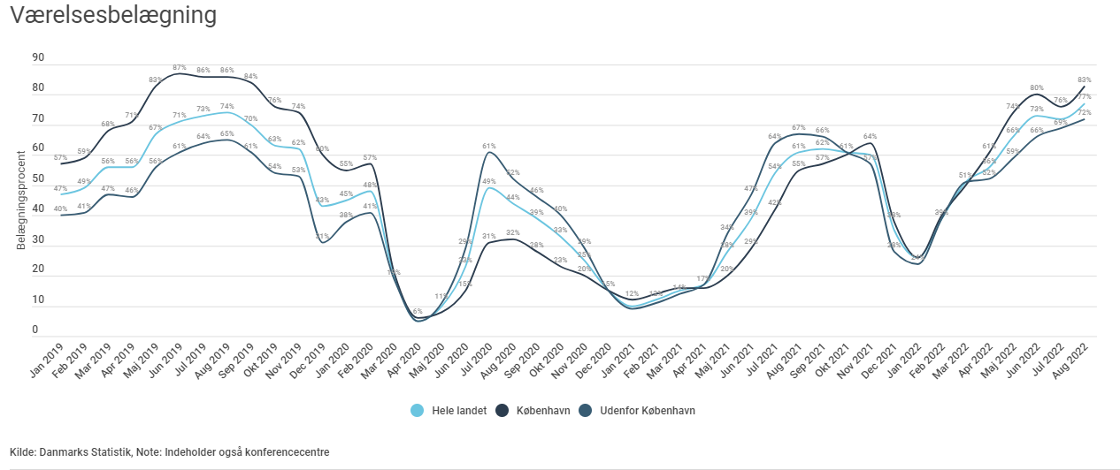
Findings – The hotel sector in Copenhagen

Slide 5
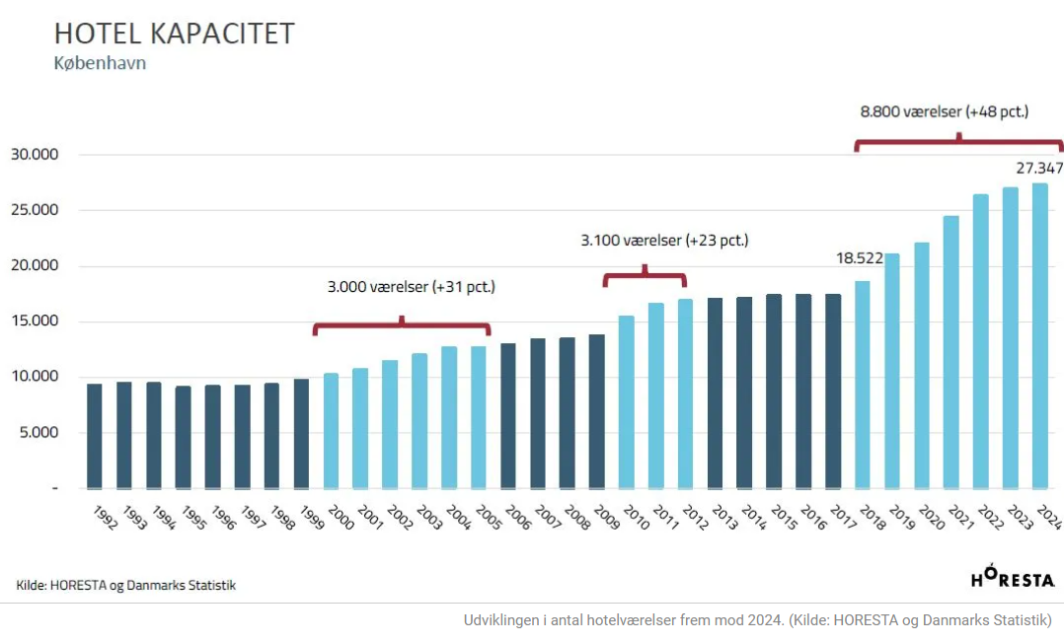
Findings – The hotel sector in Copenhagen

Slide 6
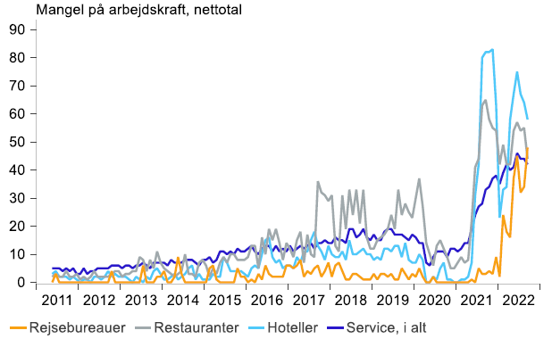
Findings – The hotel sector in Copenhagen
Lack of employees. Dansk Erhverv og Deloitte 2022

Slide 7
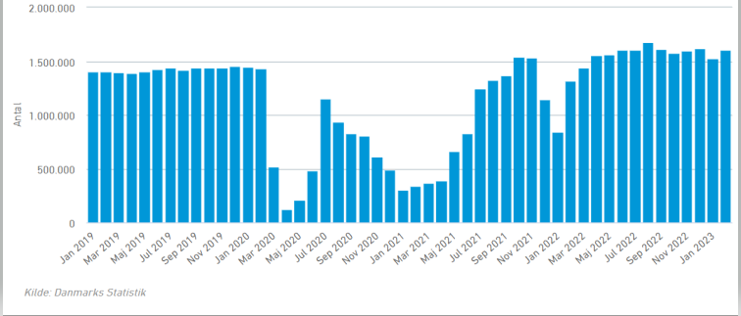
Occupancy level – Danish hotel sector

